Slide 1
BBSR’s Best Practices in Reproducible Research and Some Basic Guidance on Data

Slide 2
Need
The need to uniformly employ best practices for data analyses and application development
Increasing need to hand off projects between data scientists
Increasing requests by journals and funding agencies to provide easily reproducible analytic steps

Slide 3
Moffitt-BBSR Reproducible Research Initiative
Steering Committee
David Boulware
Rodrigo Carvajal
Ling Cen
Ann Chen
Guillermo Gonzalez
Jose Laborde
Mahrukh Naqvi
Richie Reich
Paul Stewart
AC Tan
Jamie Teer
Ram Thapa
Zach Thompson
Xiaoqing Yu
Backers
Brooke Fridley
John Schatzle

Slide 4
Reproducible Research Steering Committee
Purpose:
To guide, plan, and implement practices that improve the efficiency, quality, accountability, and reproducibility of project work in the BBSR.
Objectives:
Utilize a standard file structure for all BBSR projects
Apply version control to all BBSR projects
Maximize the use of automated analysis and reports in BBSR
Utilize coding conventions for best practices
Implement a second person review process for BBSR

Slide 5
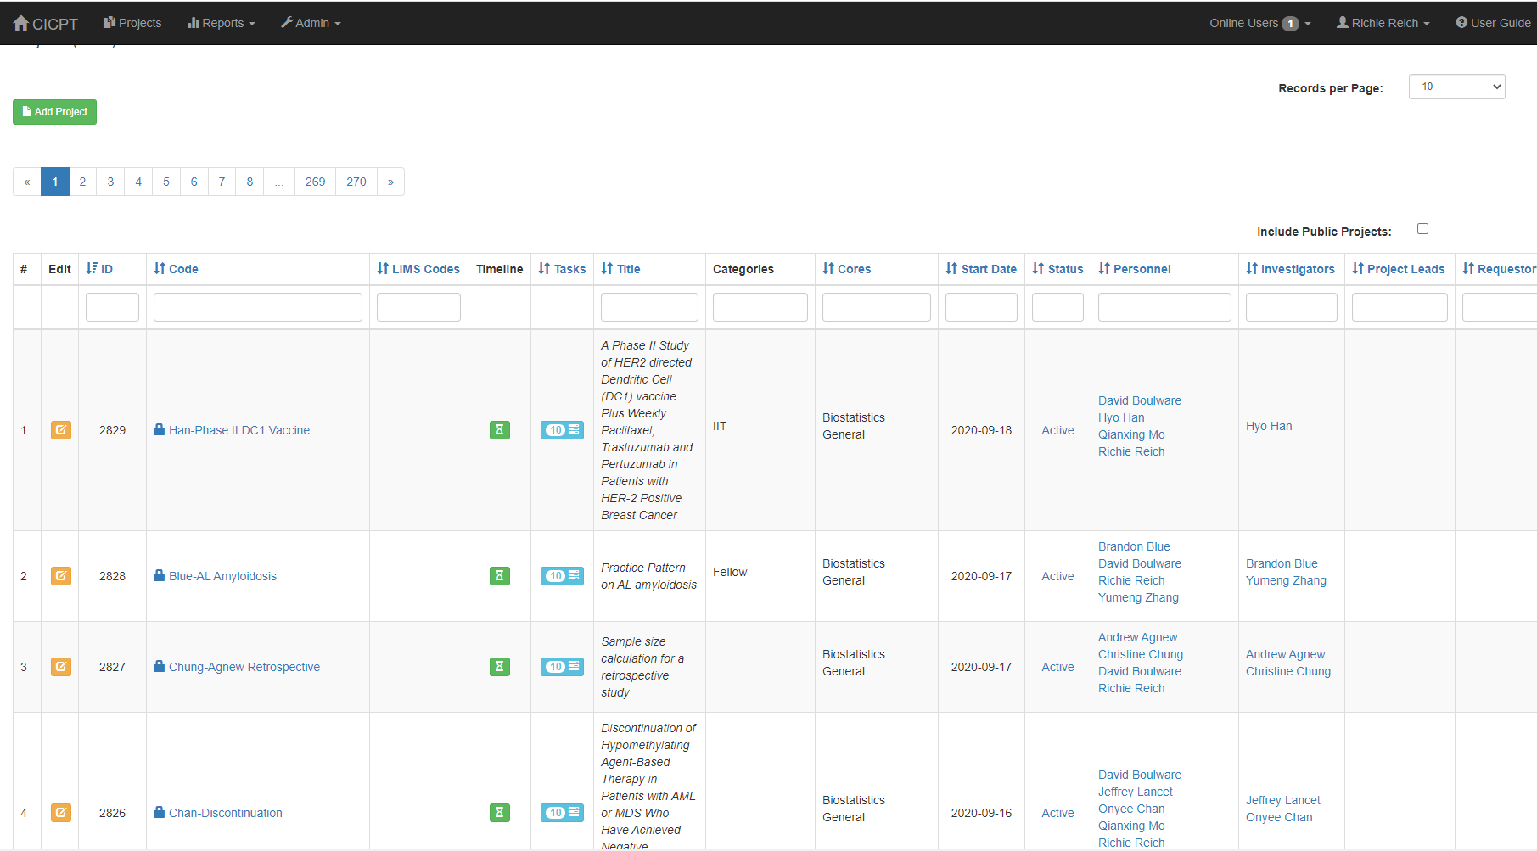
Centralized Information Hub for All Projects
CICPT:

Slide 6
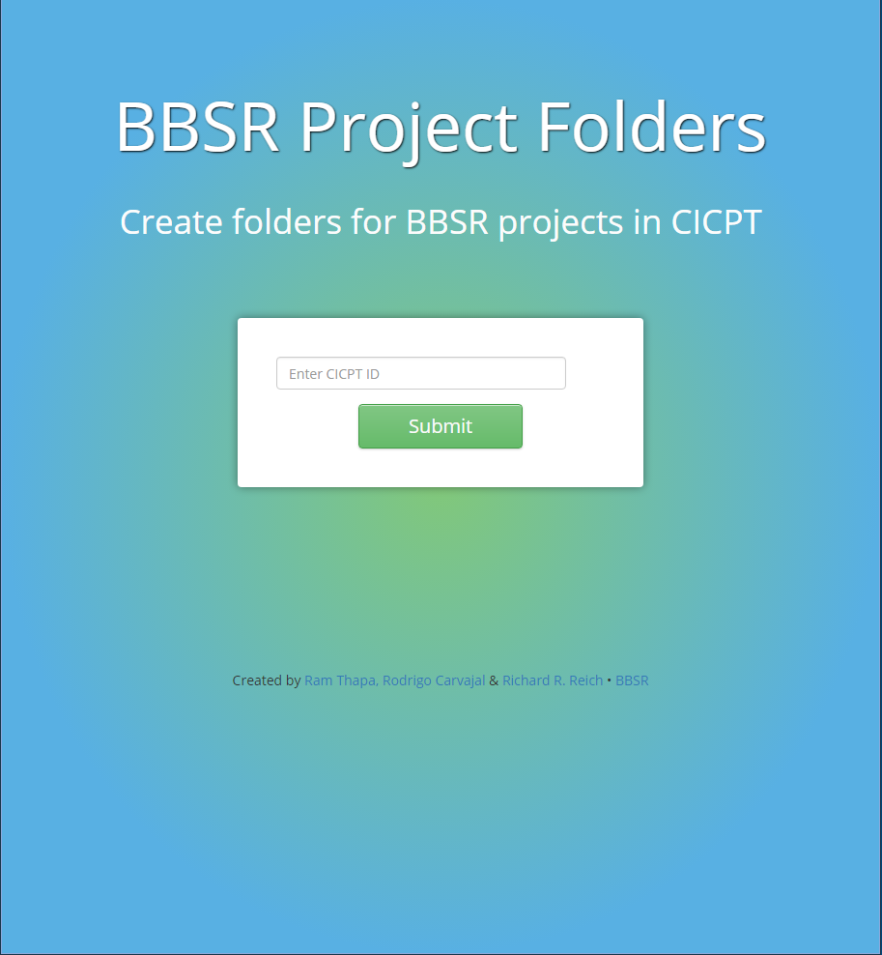
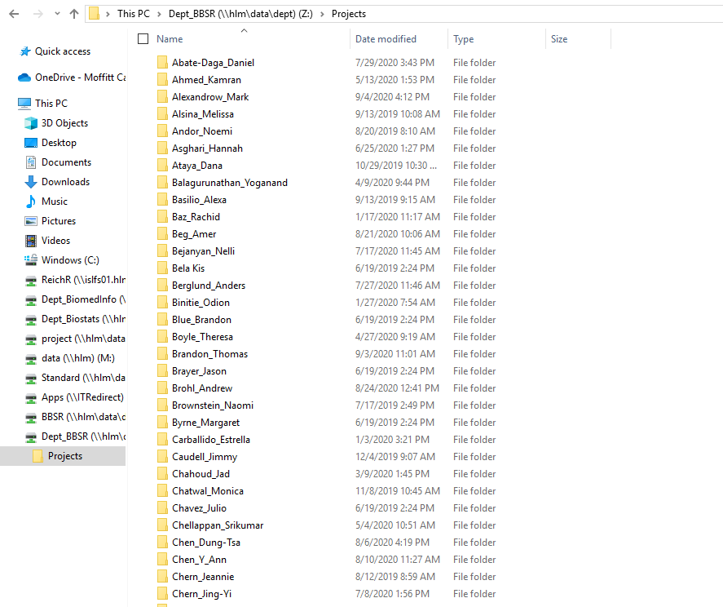
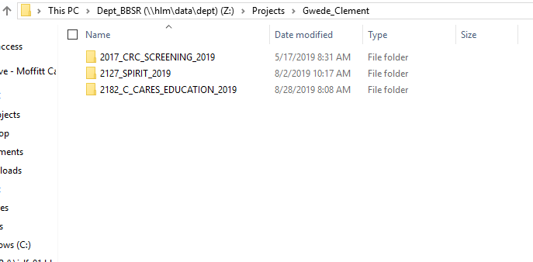
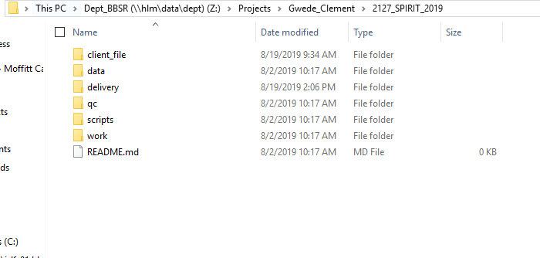
Objective 1: Common File Structure

Slide 7
Objective 2: Version Control
Version control is vital for reproducible research, being able to easily track versions of code and analyses.
In GitLab we have created a private group called “BBSRProjects”, which is where any project repositories can live, which would be equivalent to saving work on the Dept_BBSR Drive.

Slide 8
Objective 3: Automation
SAS Macros
R Functions
Omics analytics pipelines
Reports
Web applications

Slide 9
Objective 4: Coding Conventions
Provide detailed notes and annotation of code
Use code conventions specific to the programming language being used.
Use macros/functions to reduce repetition of code.

Slide 10
Objective 5: Second Person Review
A positive (non-punitive) review environment for staff and faculty code improvement in the areas of understandability, reproducibility, accuracy, and efficiency.
Frequency of Review: Code reviewed two times per year for each member of the BBSR.

Slide 11
Implementation
Teach/Train:
Experts in RR Steering Committee
BioData Club
Incentivize: Inclusion in annual review as indicator of Excellence.

Slide 12
Challenges
Converting practice
The “correct” choices in automated analyses
Freedom
IT dependencies

Slide 13
Next Steps
Ongoing adoption of reproducible research best practices
Ongoing development of automated tools
Create centralized webpage for all reproducible research resources
Spread the word

Slide 14
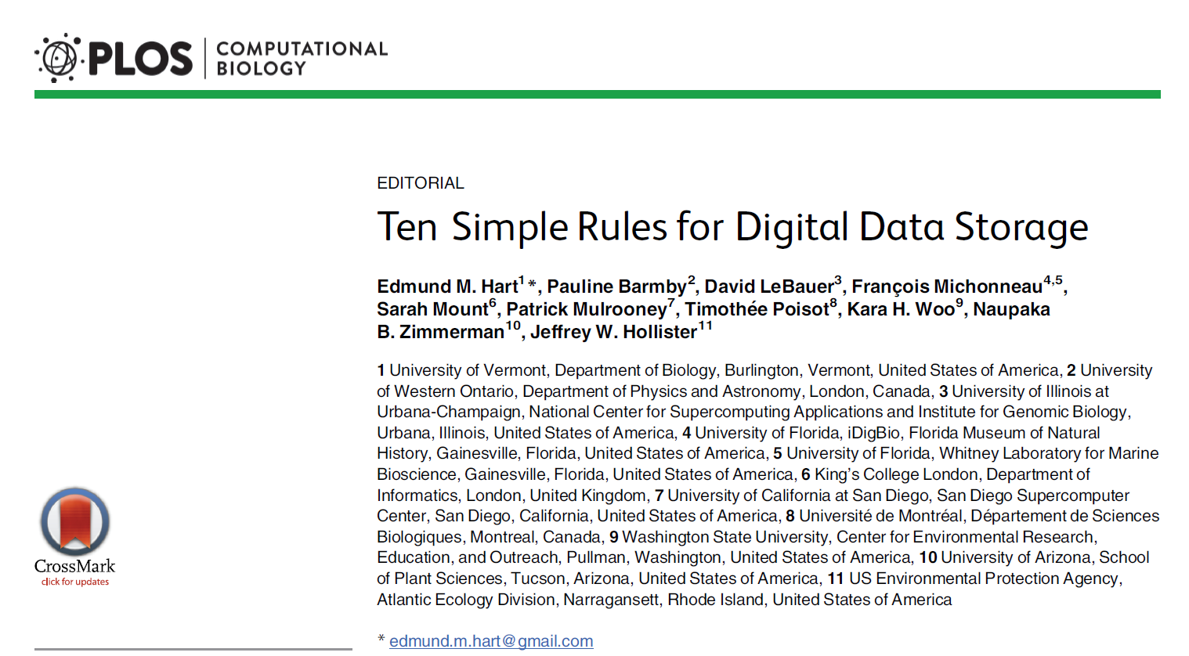

Slide 15
Overview
Data can be:
Large
Shared by many people
Multi-faceted
Changing
Accessed publicly
This article provides guidance on how to avoid pitfalls

Slide 16
Rule 1
Plan ahead
How it will be received
Format should be consistent with standard formats and how it will be analyzed
Size and timeframe

Slide 17
Rule 2
Know what you will be doing with the data
Will raw data come in once or over time?
Automate processing/corrections (with documentation) as much as possible
Log all changes to the original data
Will data be released to others?
Format needed?
Privacy concerns?
Institutional permission
Does the funding source mandate release? If so, where?
Does the target journal mandate release?

Slide 18
Rule 3
Keep raw data pristine
Separate and store in its original form
Document changes
Cryptographic hash to check if data has changed
Code where output changes dramatically if the data has changed
Available in SAS and R

Slide 19
Rule 4
Store data in open format
Use a format that is universal, not requiring proprietary software
Yes: CSV, JSON, XML
No: XLSX, SAV, SAS7BDAT
For analysis purposes, proprietary programs have code for conversion

Slide 20
Rule 5
Structure Data for Analysis
Easy to manipulate using familiar software
Variables in columns, observations in rows
Label variables in a way that maps on to existing standards (common across studies)

Slide 21
Rule 6
Make data identifiable (naming conventions)
Name dataset in a way that is consistent with repositories
Consistent date formats (e.g., 2020-09-18)
Specific titles (e.g., include project identifier number)
An example of versioning is “Major.Minor.Patch” (e.g. 1.2.1)

Slide 22
Rules 7-10
Rule 7: Document well
Provide information about the project
Create a data dictionary
Rule 8: Privacy concerns
De-identify
Limit Access
Rule 9: Back up the data
To other physical locations
Know the back-up frequency of your institution
Rule 10: Practical considerations
Speed
Access
Cost

